Slide 1
LOW QUALITY DEFECT IMAGE RECONSTRUCTION AND RECOGNITION USING GAN BASED DEEP LEARNING MODEL
A Presentation By:
G. Sai Priyatham 16331093
N. Swetha 16330344
J. Bhashitha 16331262
M. Deva Sri Sasikala 16331102
- FREE THINKERS

Slide 2
ABSTRACT
In vision-based defect recognition, deep learning (DL) is a research hotspot. However, DL is sensitive to image quality, and it is hard to collect enough high-quality defect images.
The low-quality images usually lose some useful information and may mislead the DL methods into poor results. To overcome this problem, this paper proposes a generative adversarial network (GAN)-based DL method for low-quality defect image recognition.
A GAN is used to reconstruct the low-quality defect images, and a VGG16 network is built to recognize the reconstructed images. The experimental results under low-quality defect images show that the proposed method achieves very good performances, which has accuracies of 95.53%-99.62% with different masks and noises, and they are improved greatly compared with the other methods.
Furthermore, the results on PSNR, SSIM, cosine and mutual information indicate that the quality of the reconstructed image is improved greatly, which is very helpful for defect analysis.

Slide 3
INTRODUCTION
In modern manufacturing system, vision-based defect recognition is an important technology to guarantee product quality, which provides a fast and stable way to classify defect types.
Thus, vision-based defect recognition has drawn many attentions, which has been widely in many industrials, including steel, LCD, wood and welding .
Recently, several vision-based defect recognition methods had been proposed, and deep learning (DL)-based methods have become one of the research hotspots, due to their outstanding performances. Park and Kweon proposed an ambiguous surface defect classification method for smartphones.
Deep learning algorithms will be trained on images and then this algorithms are used to classify images or detect objects from image but sometime due to low quality images deep learning prediction accuracy or quality will be degrade and to overcome from this problem author in this paper has discuss two algorithms using which we can increase quality of low quality images and then recognized defects from those images.

Slide 4
EXISTING SYSTEM
In Existing System, Deep Learning is sensitive to image quality, and it is hard to collect enough high-quality defect images. The low-quality images usually lose some useful information and may mislead the DL methods into poor results.

Slide 5
PROPOSED SYSTEM
Low-quality defect images can be recognized using a generative adversarial network (GAN)-based DL approach proposed in this paper. For the low-quality defect images, the GAN is utilized to reconstruct them, and a VGG16 network is then developed to recognize them.
GAN algorithm helps in generating new improved quality images from given low quality images and this improved high quality images may help deep learning algorithms in predicting images correctly. GAN helps in reconstructing new image from low quality image.
High quality image will be input to VGG-16 algorithm which recognized image and presence of defects in that image.

Slide 6
GAN (GENERATIVE ADVERSARIAL NETWORK )
GANs are Neural Networks that accept random noise as input and produce outputs that seem like a sample from the training set's distribution and they are used for Unsupervised Learning.
The two components of GANs are Generator and the Discriminator where these two models are trained simultaneously.
GANs improves the resolution of an image i.e. from low resolution to high resolution, has an ability to generate synthetic images and also able to generate images from descriptions.
The generator model generates images from random noise(z) and then learns how to generate realistic images. Random noise which is input is sampled using uniform or normal distribution and then it is fed into the generator which generates an image.
Discriminator is a Convolutional Neural Network consisting of many hidden layers and one output layer and it is trained on the real data so it learns to recognize how actual data looks like and what features should the data have to be classified as real.

Slide 7
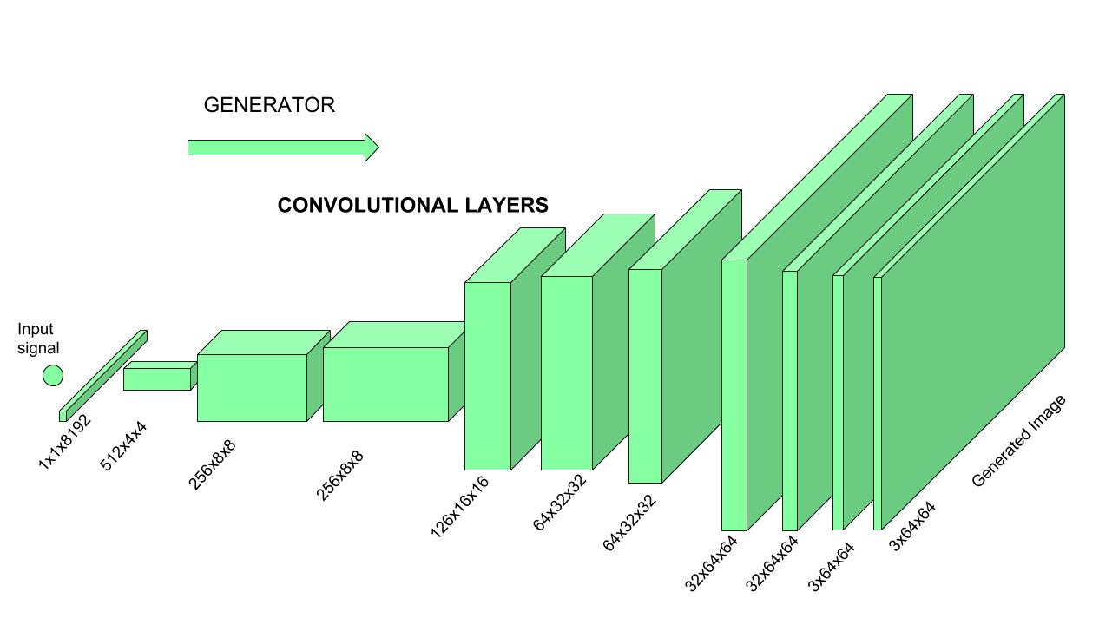
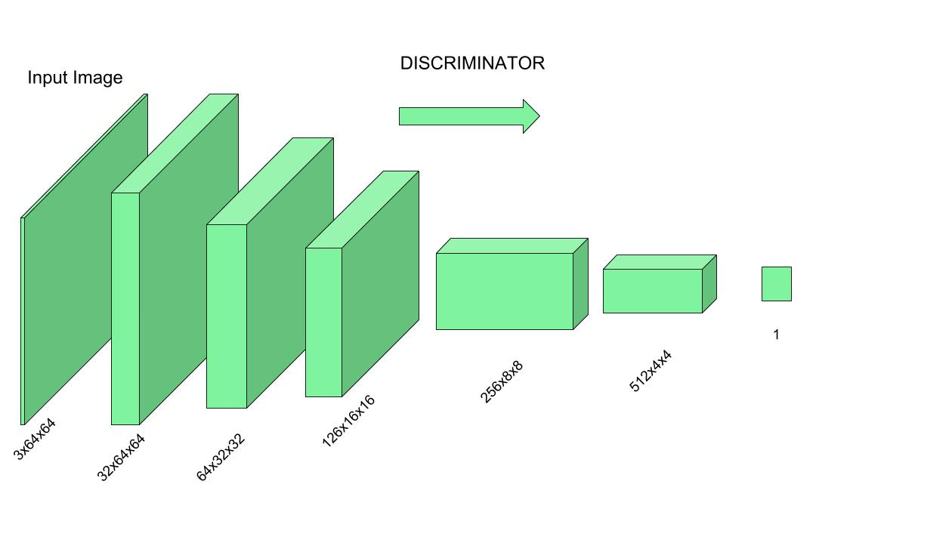
GENERATOR AND DISCRIMINATOR
GENERATOR
DISCRIMINATOR

Slide 8
PRINCIPLE OF GAN
Now the Generator starts to generate data from a random input and then that generated data is passed to Discriminator as input now Discriminator analyzes the data and checks how close it is to be classified as real, if the generated data does not contain enough features to be classified as real by the Discriminator, then this data and weights associated with it are sent back to the Generator using backpropagation, so that it can readjust the weights associated with the data and create new data which is better than the previous one.
This freshly generated data is again passed to the Discriminator and it continues. This process keeps repeating as long as the Discriminator keeps classifying the generated data as fakes, for every time data is classified as fake and with every backpropagation the quality of data keeps getting better and better and there comes a time when the Generator becomes so accurate that it becomes tough to distinguish between the real data and the data generated by the Generator.

Slide 9
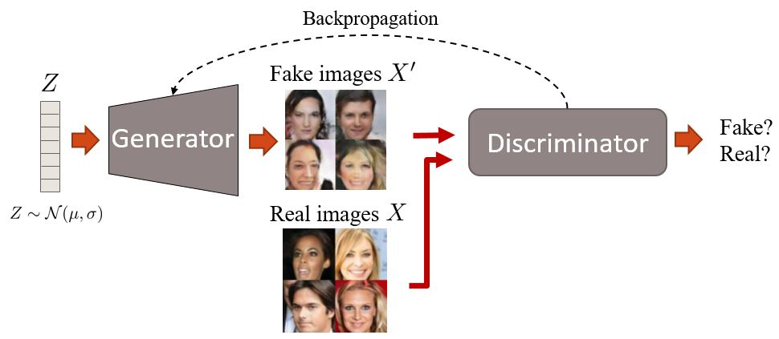
PRINCIPLE OF GAN

Slide 10
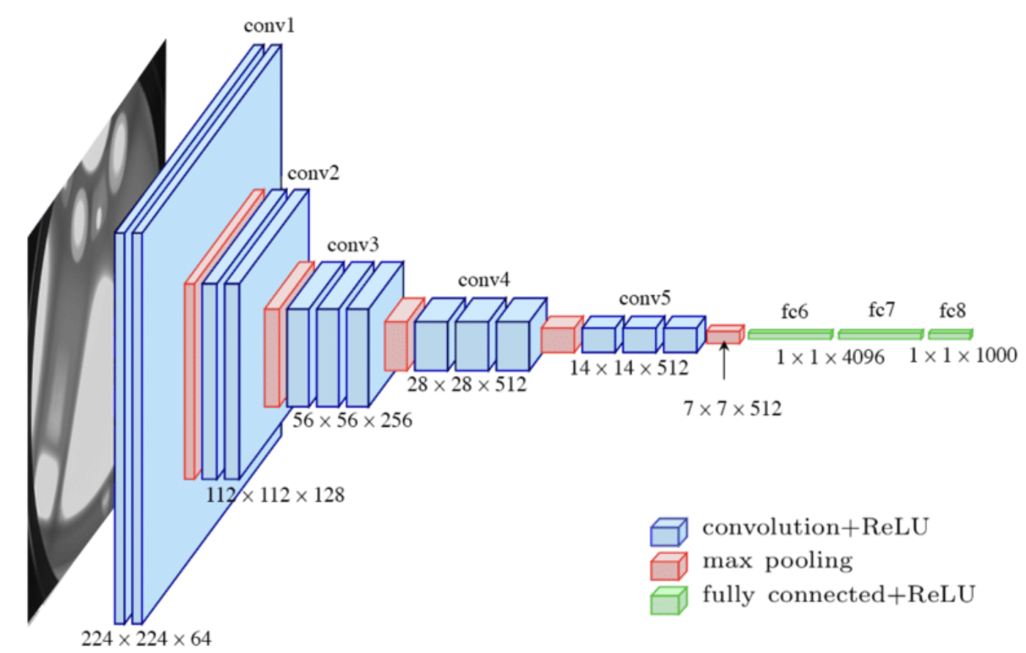
VGG16
VGG16 has thirteen convolutional layers, five max-pooling layers, and three fully linked layers. As a result, there are 16 layers with configurable settings (13 convolutional layers and 3 fully connected layers). VGG16 is the model's name for this reason.
The first block has 64 filters, which are subsequently doubled in subsequent blocks until the total number of filters reaches 512. Two fully linked hidden layers and one output layer complete this model.
The neuron counts in the two fully linked layers are the same, at 4096. The output layer has 1000 neurons, which corresponds to the ImageNet dataset's number of categories.

Slide 11
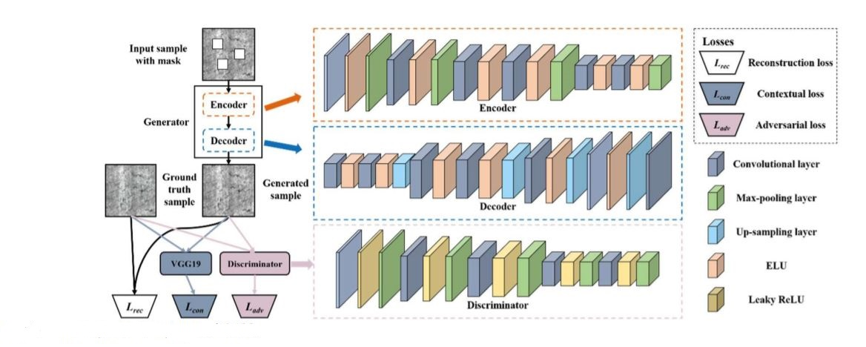
SYSTEM ARCHITECTURE
The architecture consists of GAN model which involves constructing the images from the generator and identifying the reality of the images using discriminator and then using VGG16 model to identify the defects in the image and reconstruct the high quality image.
Training and testing of the data in such a way that we make accurate predictions by reducing the loss using appropriate optimizers thereby changing the weights and learning rate.

Slide 12
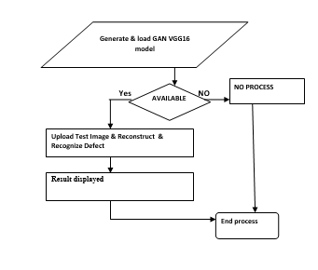
IMPLEMENTATION
We have imported many libraries such as tkinter, matplotlib, NumPy, TensorFlow and then we constructed a GAN and VGG16 and loaded our model.
Trained the model with the training images from NEU-dataset and VGG16 will be trained on low quality images and then we need to test the model with the new images.
Uploaded the low quality test image and whenever we upload test image then VGG16 will recognize defects from that image as it is trained with low quality images the reconstructed image is displayed and here we considered two different types of defect images such as Crazing and inclusion.
Quality of the image can be found using PSNR,MI,SSIM.

Slide 13
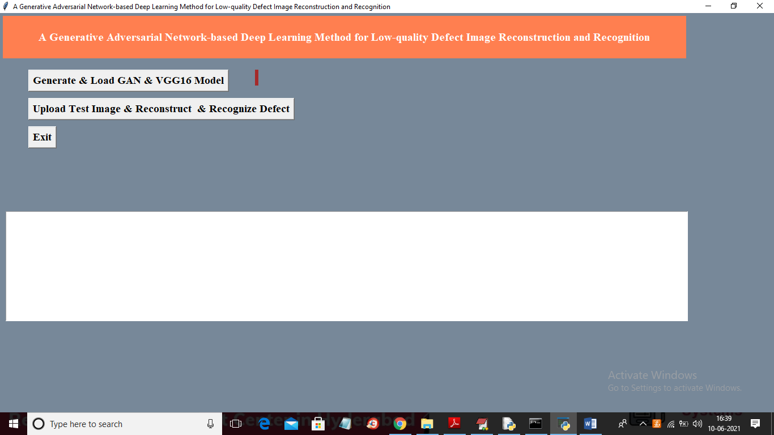
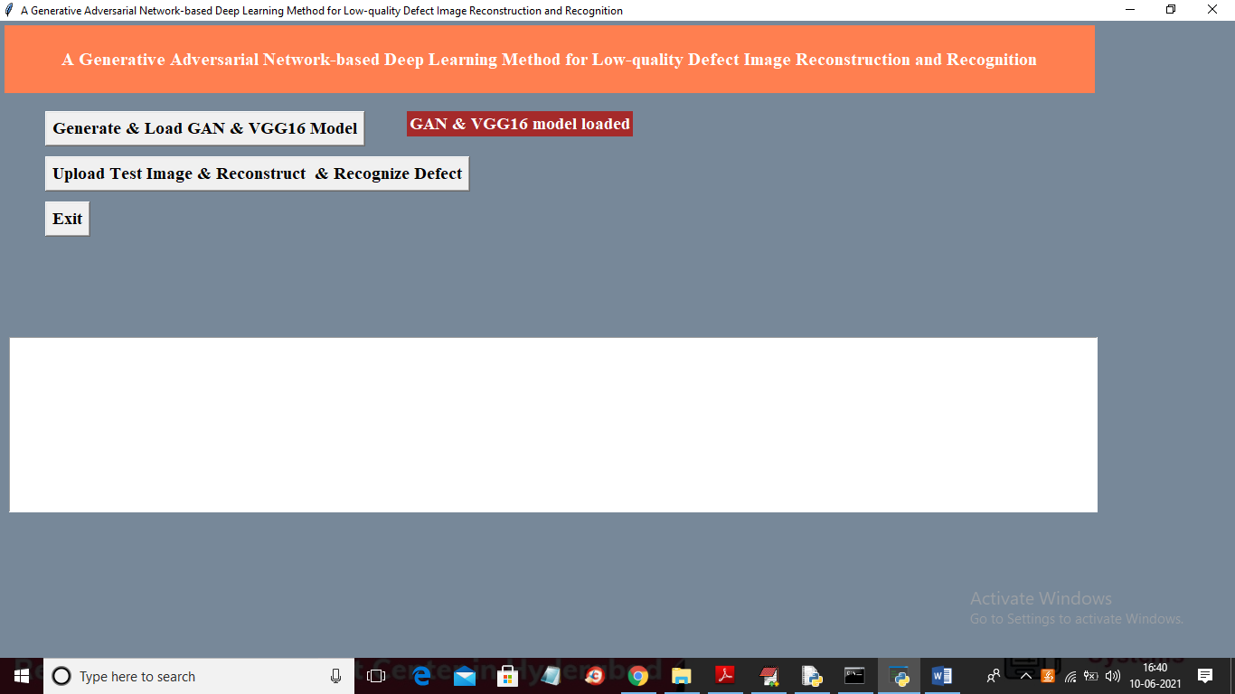
TEST REPORTS
This is the front end window which appears when we run our code.
Generated GAN and VGG16 model and then loaded them.

Slide 14
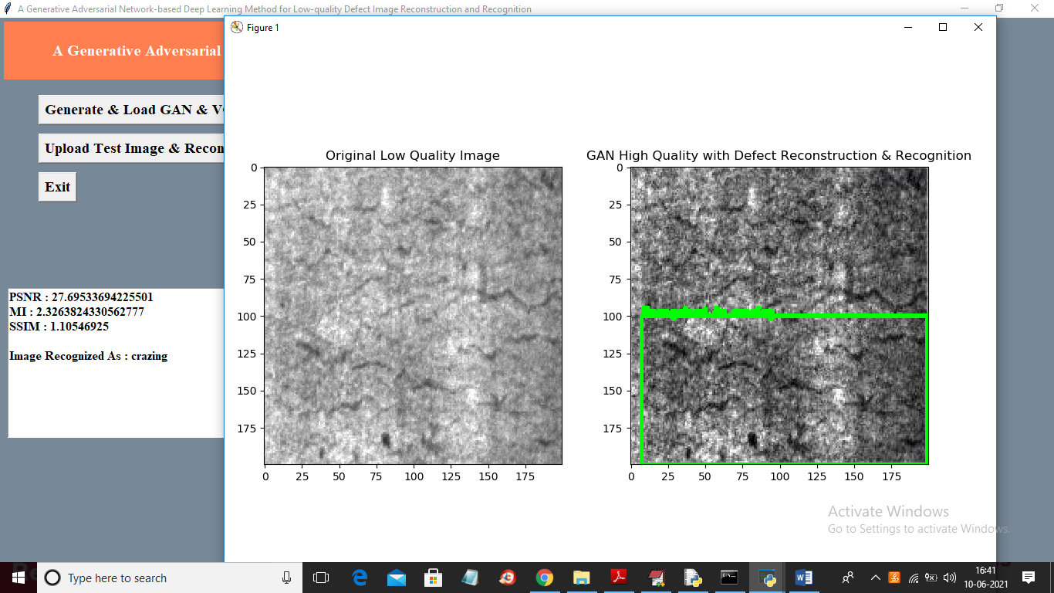
TEST RESULTS
VGG16 is trained on defect images and here the defect is Crazing.
We can see image defect recognized as ‘inclusion’ and we can observe quality of both images where first is original image and second is the GAN generated image and then we can see green bounding box surrounded across defected area.
PSNR, MI and SSIM values are calculated and where PSNR closer to 1 indicates that image quality is increased.

Slide 15
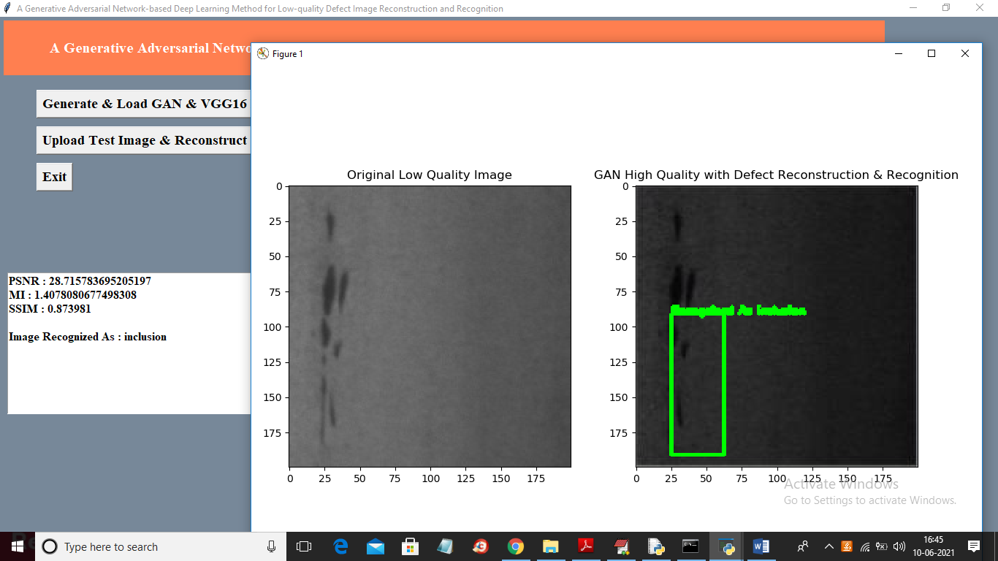
TEST RESULTS
VGG16 recognizes the defect and we can see defect in image is recognized as ‘crazing’.
We can see first image is the low quality images and then second image is the GAN generated image and its quality is looking good compare to first image and in above image you can see green bounding box surrounded to big black dot which is recognized as defect.
Our model increase quality of low quality images and then recognized defects from those images.

Slide 16
CONCLUSION
DL is a research hotspot in vision-based defect recognition. However, most of the current DL methods are sensitive to the image quality, and a low-quality image might cause the models not to work well as expected.
To address this problem, this paper proposes a GAN-based DL method for low-quality defect recognition. The main contributions of this paper are summarized as follows.
Firstly, this paper proposes a new manner that uses GAN to reconstruct the low-quality defect images and improve image quality. The reconstruction could avoid the explicit design for operators or manual image repair.
Secondly, the proposed method is generic, and it not only shows the effectiveness on the noisy image but also on masked images, which has not been considered in the previous yet.
Finally, a VGG16 network with global average pooling is built to recognize the reconstructed defect images. The experimental results manifest that the proposed method is effective for the low-quality defect recognition tasks, and outperforms the other defect recognition methods.

